Slide 1
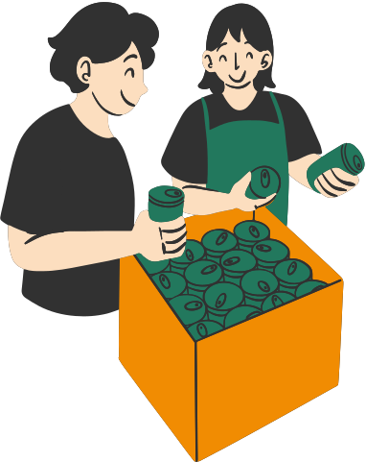
FOOD DONATION APP: SOLVING HUNGER, ONE DONATION AT A TIME

Slide 2
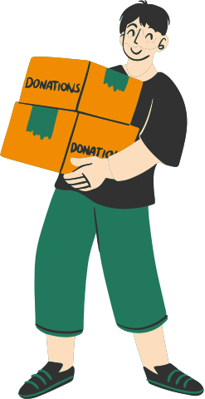
PROBLEM STATEMENT
Despite large amounts of surplus food being wasted globally, efficient systems to redistribute it to those in need are lacking. How can we create sustainable solutions to reduce food waste and ensure it reaches people facing hunger?

Slide 3
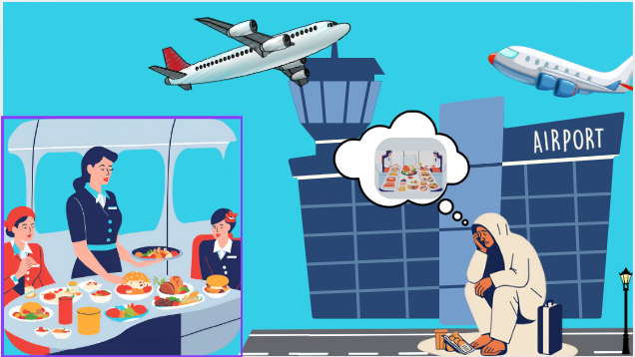
STORY BOARDING
Problem: Airports and train stations prepare large amount of meal that often have leftover prepared food at the end of the day, especially in peak travel seasons.
Pain Point: Food vendors tend to throw away uneaten meals because they cannot sell them the next day.

Slide 4
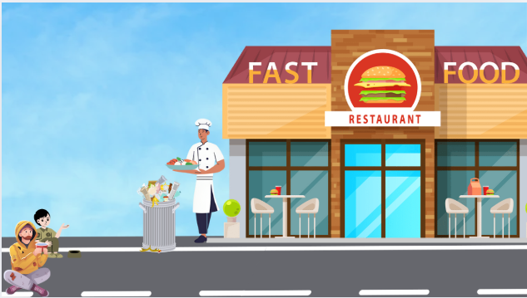
STORY BOARDING
Problem:A hotel’s buffet has untouched platters left after service. The app allows hotel staff to notify nearby orphanages and shelters, ensuring food is distributed before it spoils.
Pain point: Ensuring timely and efficient communication between the hotel staff and nearby orphanages/shelters, so food can be distributed before it spoils.
07

Slide 5
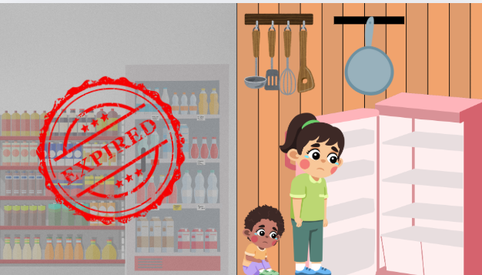
STORY BOARDING
• Problem: Grocery stores often have food nearing its expiration date that can no longer be sold but is still safe to consume.
• Pain Point: The food is discarded when it could be used by those in need.
07

Slide 6
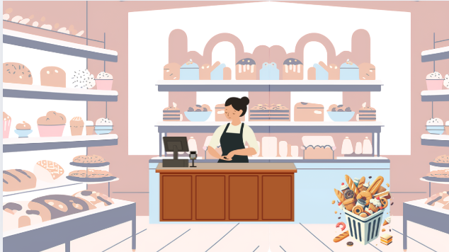
STORY BOARDING
Problem: The bakery leftover problem is the challenge of managing unsold baked goods at the end of the day, leading to food wastage.
Pain point: Finding a quick and effective way to donate or redistribute unsold products before they become stale or go to waste.
03

Slide 7
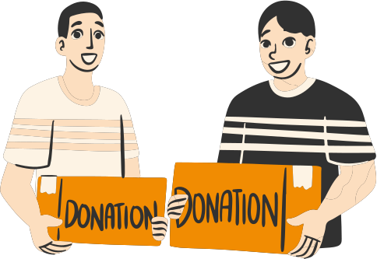
INOVATION TYPE
SUSTAINABLE INNOVATION
Reduces environmental impact and promotes resource efficiency.
Connects NGOs with food providers to reduce food waste.
Addresses hunger by redirecting surplus food to those in need.
"Remember that the happiest people are not those getting more, but those giving more."
04

Slide 8

“I don’t like wasting food.”
“There should be a way to
donate food easily.”
“I want to help reduce food waste, but I’m not sure how.”
SAY
THINK
EMPATHY MAPPING
USERS
FEEL
DO
Guilty about wasting food.
Hopeful to make a positive impact.
Often throws away food when it’s not consumed.
05

Slide 9
USER JOURNEY
ACTION | TOUCHPOINTS | EMOTIONS
User searches for food donation options | Website app, Social media | Unsatisfied
User tries to donate foood | Donation forms, Contacting NGO’s | Hopeful
Donation is completed | Email confirmation, Thankyou message | Gratified

Slide 10
IDEATION:
PROBLEM | PROPOSED SOLUTIONS
Bakery Leftovers | Implement a real-time donation app where bakeries can list surplus food and notify local shelters.
Airport Food Leftovers | Set up food collection kiosks near airports where NGOs can collect unsold packaged meals for quick distribution.
Supermarket Expired Products | Use AI-powered sorting systems to categorize near-expiry items and distribute safe, edible food to food banks.
Hotel Food Leftovers | Introduce food safety certification for donors to ensure donated food meets quality standards.
Wedding and Large Events | Partner with event planners and caterers to integrate a food donation system that redistributes excess food post-event.

Slide 11
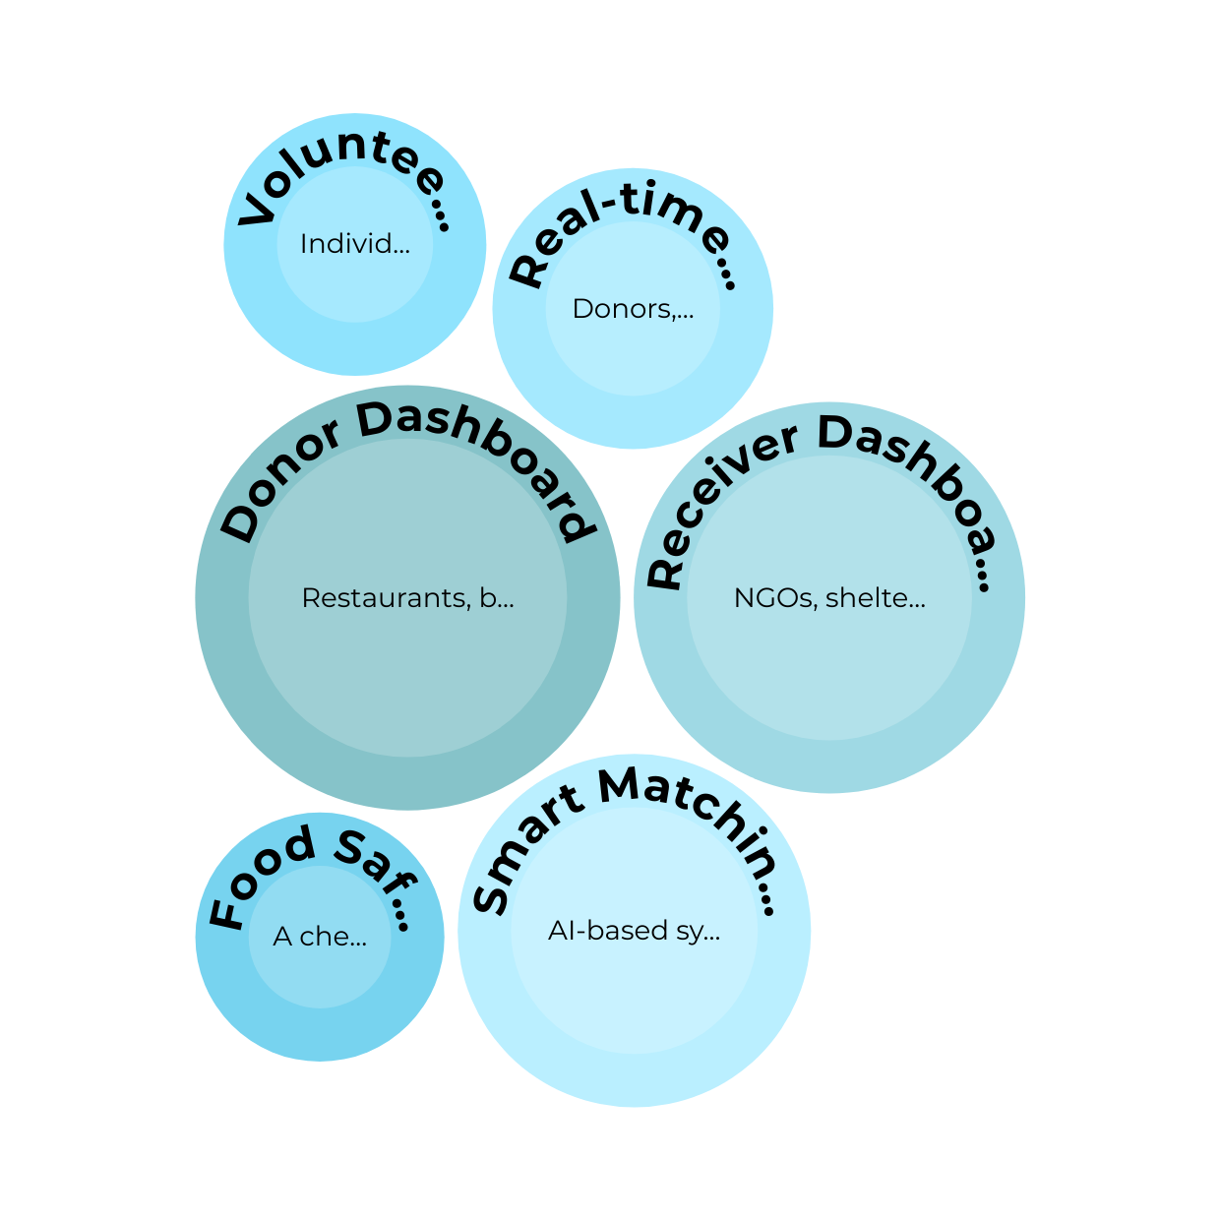
PROTOTYPE DEVELOPMENT:

Slide 12
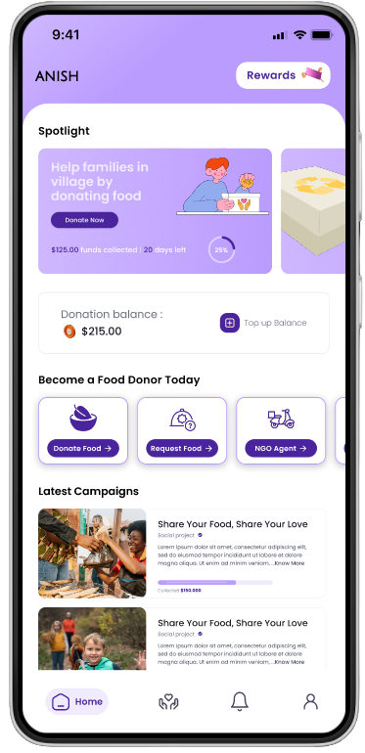
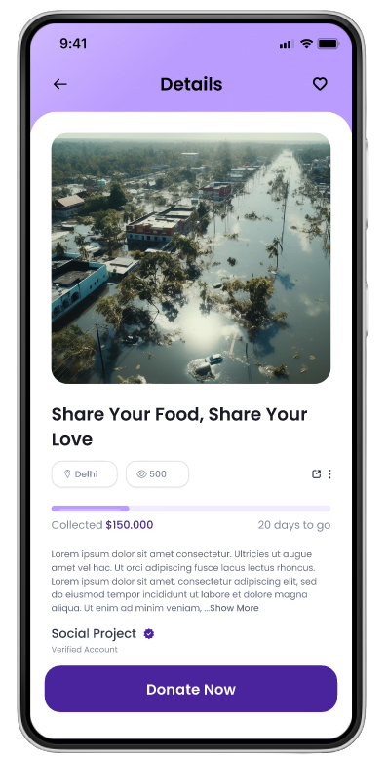
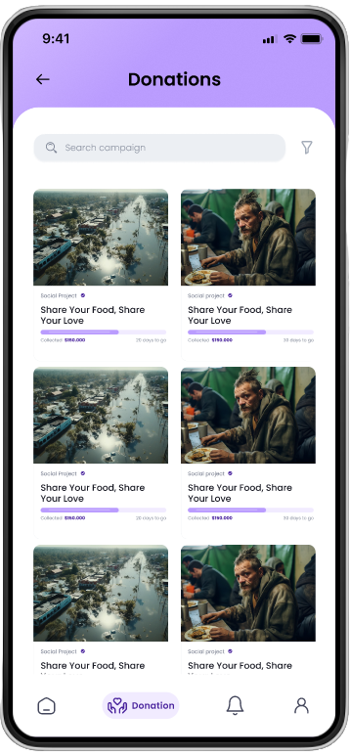
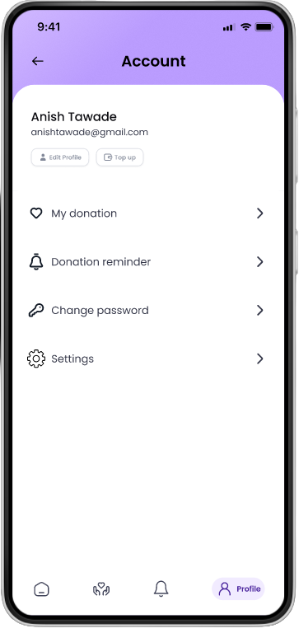
IDEATION AND PROTOTYPE DEVELOPMENT

Slide 13
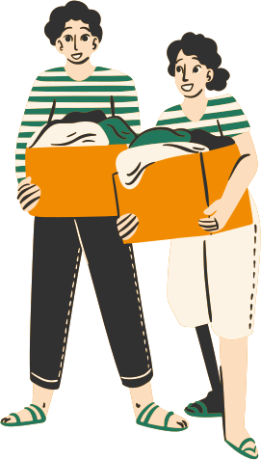
CONCLUSION
Reduces Hunger and Environmental Impact: Connects donors with receivers to efficiently redistribute surplus food.
User-Centric Design: Provides a seamless, empathetic experience for both donors and receivers.
Promotes Sharing and Responsibility: Fosters a culture of food waste reduction through community collaboration.
.
02

